Slide 1
Capstone Project-1
Airbnb
Ratnakar Gupta

Slide 2
Data Wrangling:
Missing Data
Outliers
Contaminated Data
Inconsistent Data
Invalid Data
Duplicate Data
Data Type Issues
Structural Errors
Feature Extraction
Data Visualization
Road Map

Slide 3

Airbnb
Since 2008, guests and hosts have used Airbnb to expand on traveling possibilities and present a more unique, personalized way of experiencing the world. Today, Airbnb became one of a kind service that is used and recognized by the whole world. Data analysis on millions of listings provided through Airbnb is a crucial factor for the company. These millions of listings generate a lot of data - data that can be analyzed and used for security, business decisions, understanding of customers' and providers' (hosts) behavior and performance on the platform, guiding marketing initiatives, implementation of innovative additional services and much more.

Slide 4
Problems Statement
Explore and analyze the data to discover key understandings (not limited to these) such as :
What can we learn about different hosts and areas?
What can we learn from predictions? (ex: locations, prices, reviews, etc)
Which hosts are the busiest and why?
Is there any noticeable difference of traffic among different areas and what could be the reason for it?

Slide 5
Points To Discuss
Data Profiling and Cleansing
Exploratory Data Analysis And Visualization
Relation between area and prices
Neighbourhood Analysis
Price and Reviews
Word cloud

Slide 6
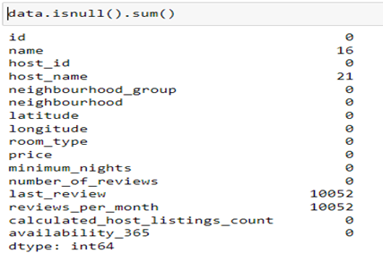
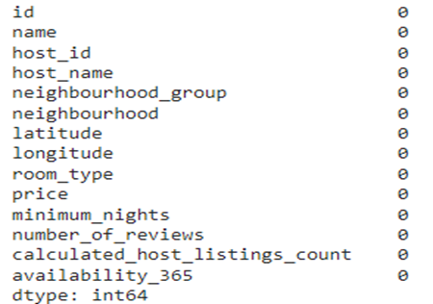
Data Profiling and Cleansing
We have 4 columns containing a missing value.
Dropping these columns "last_review" and "reviews_per_month" and replacing all NaN values in "name" and "host_name" with string 'missing values'.

Slide 7
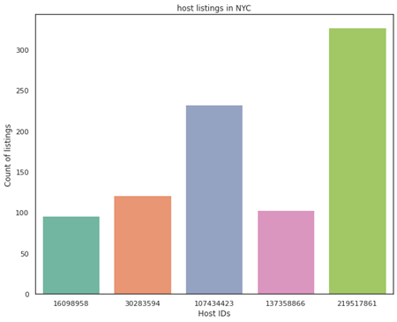
Exploratory Data Analysis And Visualization
Now we have all our data clean and we are ready for exploration of data
As we can see that the most number of hotels is shared by this host_id '219517861'.

Slide 8
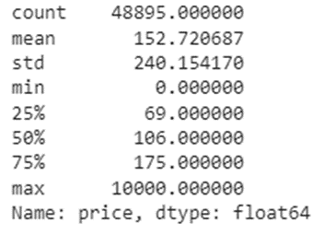
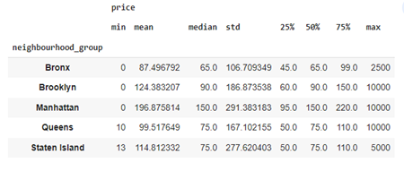
Relation between area and prices
We have investigated the relation between area and price, more specifically, the price range in each neighborhood and the distribution of listings.
As we can see that 75% of hotel's price is 175.0 so we will check the maximum percentage for price

Slide 9
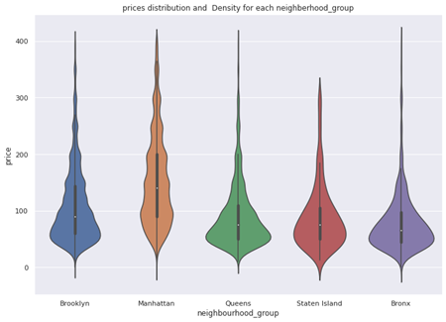
With violin plot we can identify some of things from this distribution of prices.
like 'Manhattan' is the city that has the highest range of price 196.8 and followed by brooklyn that have 124.

Slide 10
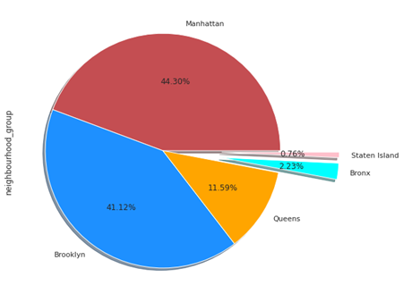
Neighbourhood Analysis
This pie chart shows that Manhattan has the highest share of listings followed by Brooklyn while the other three neighborhoods together shared less than 15% of all the listings.

Slide 11
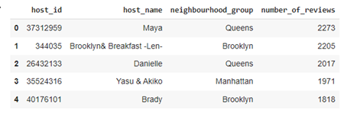
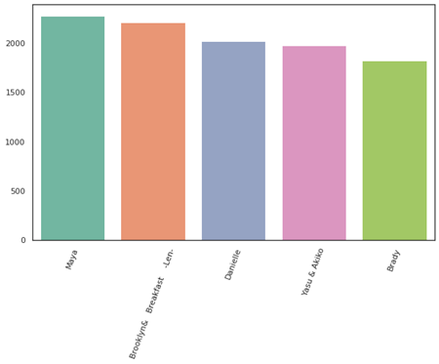
Price and Reviews
This graph shows that in these top 5 'host_name' on the basis of 'number_of_reviews' Maya has the most number of reviews and her all hotels is listed in Queens,

Slide 12
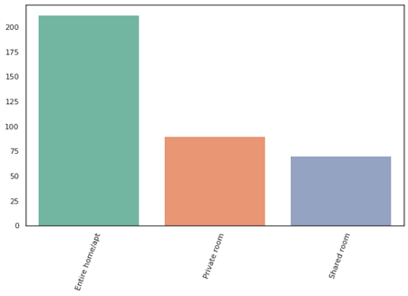
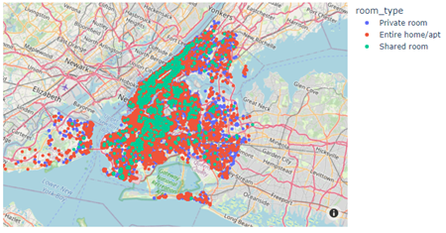
Room Type
Using latitude and longitude to plot the locations of rooms_types on the map.
'Entire home/apt' is most scattered all over the new york city.

Slide 13
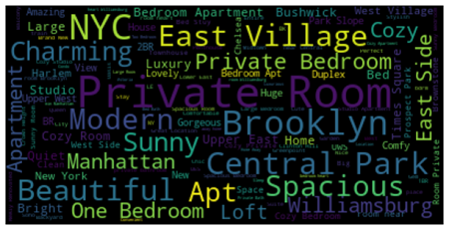
Word Cloud
We have extracted some information from the listing names. With word clouds (as shown in the following figure) we can see the top words are: 'Private Room', 'Brooklyn', 'Spacious', 'Modern', 'Beautiful' etc.

Slide 14
Conclusion
As we can see that the most number of hotels is shared by this host_id '219517861' whose host name is 'Maya'
'Manhattan' is the city that has the highest range of price 196.8 and followed by brooklyn that has 124. The Bronx is cheapest from that group.
Manhattan has the highest share of listings hotels followed by Brooklyn while the rest three neighborhoods together shared less than 15% of all the listings.
Maya has the most number of reviews and her's all hotels is listed in Queens, so on that basis we can say that she is the most busiest host among all.
'Entire home/apt' is the most expensive room type among all and 'is most scattered on all over the new york city.
With word cloud the top words are: 'Private Room', 'Brooklyn', 'Spacious', 'Modern', 'Beautiful'.

Slide 15
Q & A
Thank you

